Slide 1
Control Systems Engineer
Kurtis Bowen

Slide 2
Interests
Programming
Working with hands
Manufacturing
Team Working
CAD work
Learning new concepts

Slide 3
Advantages/Disadvantages
Great Pay
Work in and out of a traditional office
Travel
Engineering Degree required
5 Years Experience wanted

Slide 4
Physical Characteristics
Lifting up to 50 Lbs
Hand grip up to 5 Lbs
Strong Vision
Dexterity

Slide 5
Personal Characteristics
Strong communication skills
Scientific Approach
Follow time constraints

Slide 6
Salary Range
Low End: $65,000
High End: $150,000
Average salary: $79,742
Typical Hourly Pay: $36/hr

Slide 7




Companies Hiring

Slide 8
Responsibilities
Control System Maintenance
Control System Design
Maintaining/Increasing production

Slide 9
Working Atmosphere
Majority of time is spent in a cubicle
Work is done in Factories using control systems to improve prior control systems

Slide 10
Necessary Skills
Strong Communication Skills
MS Office
Strong People skills
Strong Diagnosis and troubleshooting ability
Programming

Slide 11
Interview
Interviewee
Avg. Hours
Traveling
Office atmosphere
Dress Code
Computer/People skills
?
?
?
?
?
?

Slide 12

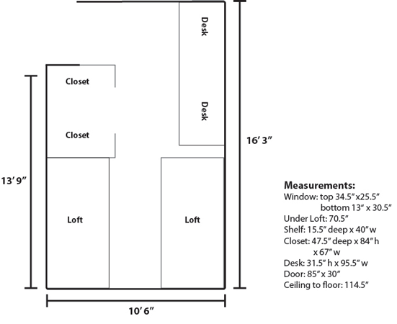
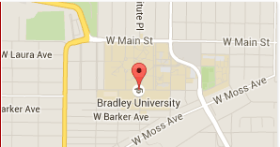
Post Secondary Education
Town Pop: 115,007
Campus Size: 5,700
Housing: School owned $9,700/yr
Tuition: $31,110/yr

Slide 13
Post Secondary Education
Student Life:
Most students stay on campus full-time
Clubs/Organizations:
Honors Societies & Active Groups
Name of Program:
Electrical Engineering With Computer Option

Slide 14
Sources
Ge.com
ControlEng.com
DakotaGas.com
GlassDoor.com
Deere.com
Novate.com
Bradley.edu
Notes:
https://xjobs.brassring.com/tgwebhost/jobdetails.aspx?partnerid=54&siteid=5346&jobid=1236524
http://www.controleng.com/single-article/control-engineering-salary-and-career-survey-2013/cd2a03c44fa44e6f1d273c30dd7fa94c.html
https://bepc.silkroad.com/epostings/index.cfm?fuseaction=app.jobinfo&jobid=216787&company_id=15914&version=3&source=ONLINE&jobOwner=956884&aid=1&jobBoardId=3337
http://jobview.monster.com/Software-Controls-Engineer-High-Speed-Control-Systems-Job-Santa-Clara-CA-US-148626525.aspx?mescoid=1700195001001

